Slide 1
Name Sawaira Nadeem
Topics : T-Flip Flop

Slide 2
Introduction
A T flip flop is known as a toggle flip flop because of its toggling operation. It is a modified form of the JK flip flop. A T flip flop is constructed by connecting J and K inputs, creating a single input called T. Hence why a T flip flop is also known as a single input JK flip flop.
The defining characteristic of T flip flop is that it can change its output state. You can change the output signal from one state (on or off) to another state (off or on).
The clock signal must set high to toggle the output. When the clock is set low, the output remains as it is whether the input signal is set high or low. So, to change the output condition, the clock signal has to be high.

Slide 3
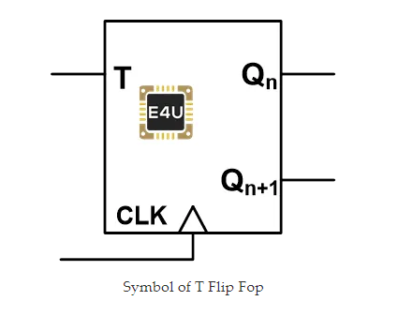
Graphical symbol of T-Flip Flop
The graphical symbol of T flip flop is as shown in the below figure.The graphical symbol of T flip flop is as shown in the below figure.

Slide 4
Truth Table Of t-flip flop
T flip flop is a single input flip flop. Along with this input, we need to give a clock signal to the flip flop. The T flip flop only works when a clock signal is high.
When the T signal is set low (0), it will not affect the present state of the output and the response will not change.
When the T signal is set high (1), if the present output status is also high (1), it converts into low (0); if the present output status is low (0), it converts it into high (1). It means it will toggle the output signal.
The below table shows the truth table of T flip flop. In this truth table, we have assumed that the clock signal is set high for all operations. Q_{n} represents the present state and Q_{n+1} represents the next state of the output.

Slide 5
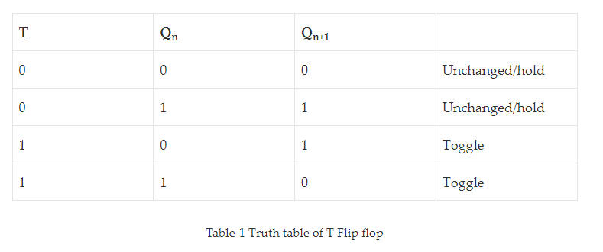
As shown in figure,

